Slide 1
March 2024

Slide 2
An ASX-listed mineral exploration and development company with a wholly owned project portfolio in Fiji that offers short, medium and long-term value.
DOME GOLD MINES LTD
IRON SAND
+
COPPER
+
GOLD

Slide 3
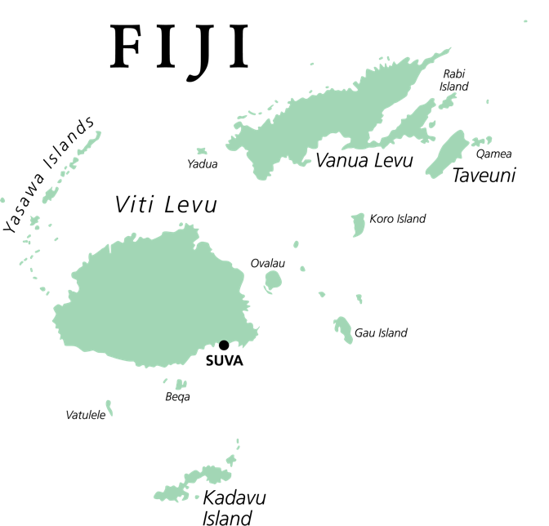
Fiji will play a strategic role in satisfying a growing global demand for minerals.
Dome has focused its project portfolio on Fiji due to its proven rich mineral deposits.
Nadrau
Sigatoka
Ono Island

Slide 4
There are a number of benefits associated with operating in Fiji:
World class mineral deposits and high exploration potential
Attractive royalty and taxation structure (20%)
Stable business environment
Reliable legal and financial systems
Skilled workforce and low-cost labour

Slide 5
Mining is an integral part of Fiji’s economy
Gold is one of Fiji’s most important exports
Mining and exploration covers gold, base metals, iron sand, bauxite, limestone/marble, aggregate, petroleum, natural gas and geothermal power
Fiji’s strategic geological setting on the Pacific Rim of Fire continues to attract multinational exploration and mining investment
Fijian mineral law is similar to the Queensland Mining Act

Slide 6
Fiji has a long mining history and high mineral prospectivity
Namosi is one of the world’s largest undeveloped copper-gold deposits with approx. 8M oz gold
+8.6MT Copper
Vatukoula Gold Mine continues to operate. 12M oz gold
The Tuvatu gold mine under construction by Lion One, a Canadian miner.

Slide 7
Dome offers a well-balanced investment opportunity of wholly owned exploration assets
Sigatoka
Nadrau
Ono
Iron Sand
Gold/Copper
Gold
Our three projects form a robust package which together can provide a long-term and profitable future.

Slide 8
SIGATOKA IRON SANDS PROJECT SPL1495 (2,522 ha)
Dome believes it is the best magnetite sand deposit in Fiji with a JORC 2012 resource estimate of
189.3M tonnes

Slide 9
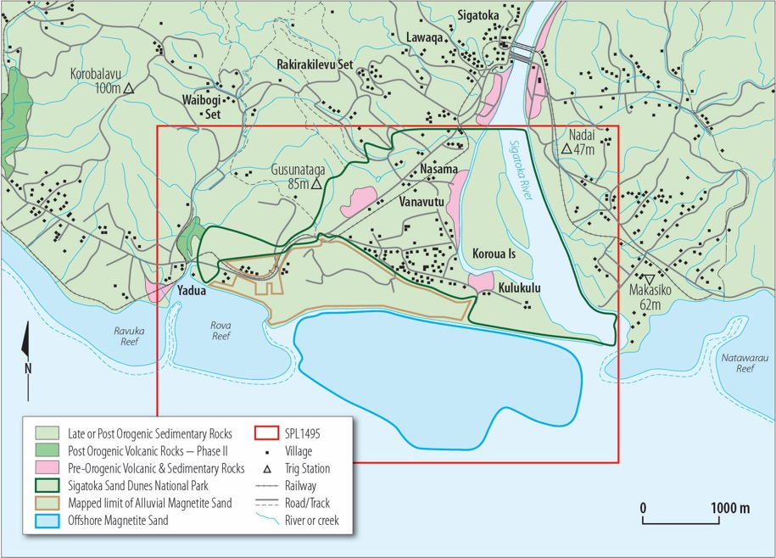
Sigatoka
Project Area

Slide 10
Sigatoka Iron Sands Project
JORC 2012 update completed
Products include magnetite (iron ore), construction sand and gravel
Resource includes very high-grade sector near river mouth
Earnings generated will drive organic corporate growth, with minimal dilution
Export markets exist across Asia for magnetite and construction sand
Local Fiji markets also require sand and gravel products
3 Stage mine development proposed
First stage to focus on the high-grade sector – sufficient for 7 years + of production
Life of the mine estimated to be 20+ years

Slide 11
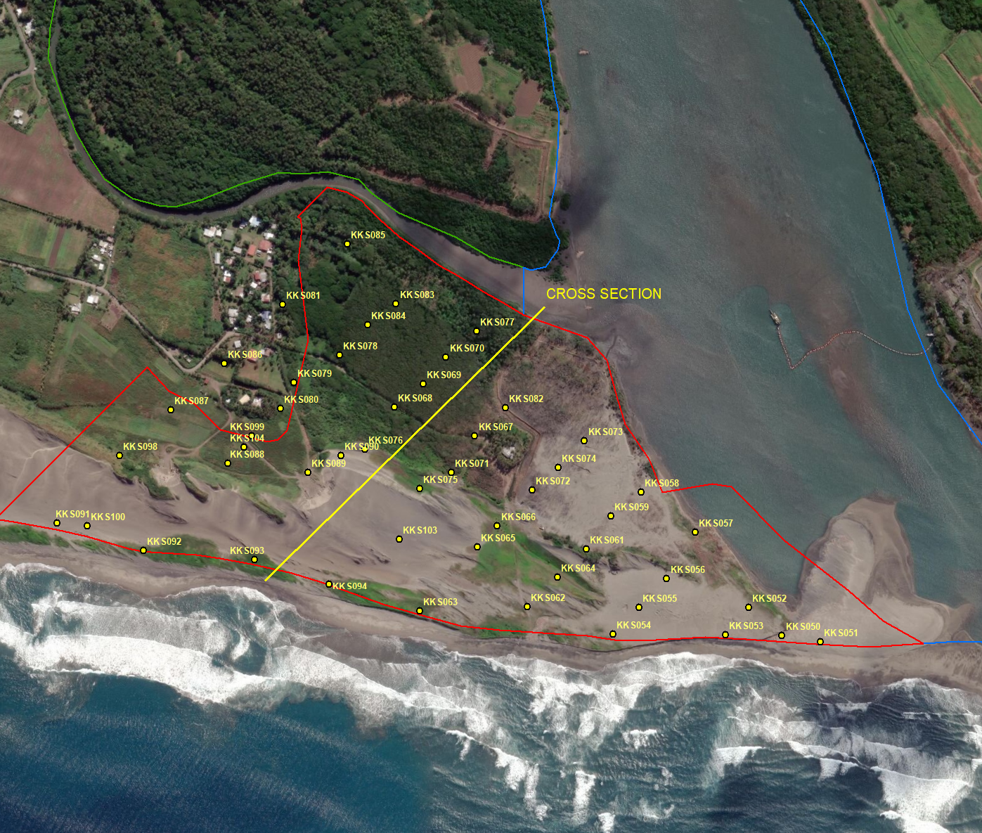
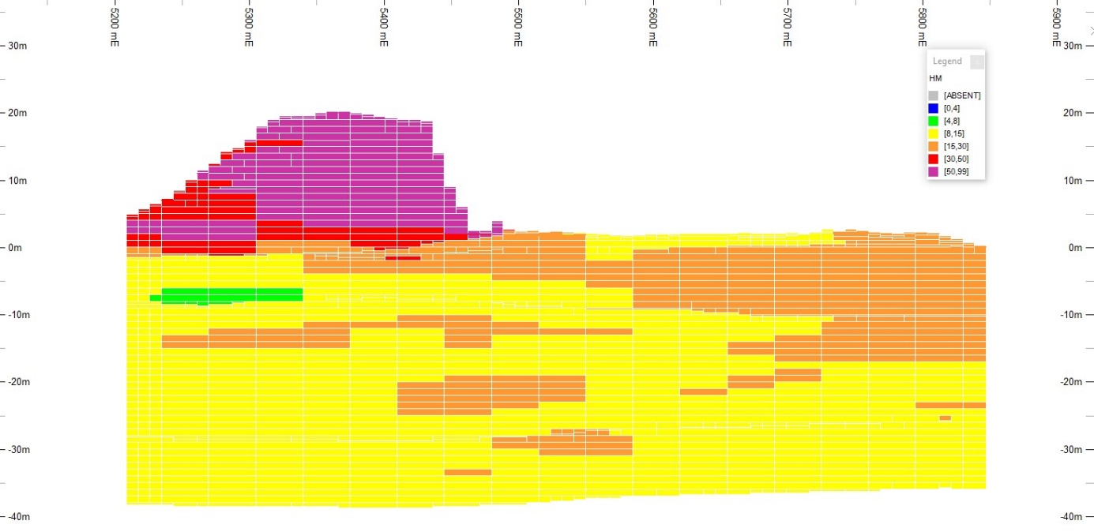
KULUKULU SOUTH
HIGH GRADE SECTOR
This sector comprises 35 Mt @ 20% Heavy Minerals.
This is sufficient for the first 7 years+ of mining.
A strong economic benefit for the project.

Slide 12
Sigatoka Iron Sands Project
Production from Sigatoka requires only modest capital, uses conventional technology and will have beneficial environmental impacts.
Products are magnetite (iron ore), construction sand and gravel
Fiji-based steel producer has indicated strong interest in buying magnetite concentrate from Sigatoka
Laboratory tests using Sigatoka sand in concrete mixes confirmed suitability for use in very high compressive strength constructions, and in aggressive marine environments
Concrete made with Sigatoka sand also demonstrated resistance to development of concrete cancer
Project is a simple, robust sand-mining operation, with minimal waste
Deepening of Sigatoka River by dredging will mitigate flooding and create potential for commercial port and river developments
Project is strongly endorsed by local people
Excellent long-term potential to expand the resource and extend mine life

Slide 13
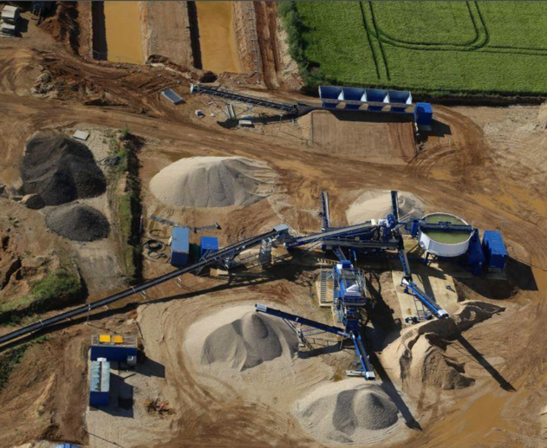
Example
Sand processing plant
IHC sand mining dredge
Mined sand is pumped to the
Processing plant
March 2024 | Slide 13
Note: Not property of Dome

Slide 14
NADRAU COPPER-GOLD PROJECT SPL1452 (33,213 ha)
Nadrau has two porphyry copper-gold prospects; Namoli and Wainivau. They are large mineral systems, similar to those at the neighbouring Namosi deposits.

Slide 15
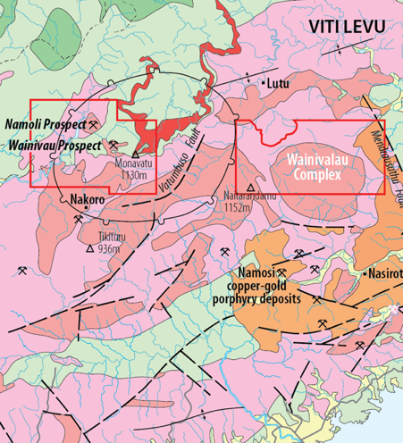
Nadrau Copper-Gold Project
Early-stage exploration
Porphyry style copper-gold mineralisation has also been observed in outcrop
Targets defined by copper and gold geochemistry
Historic drilling (1970’s) at Wainivau intersected long intervals of anomalous copper mineralisation on margins of Dome’s prospect
Further target definition planned, including geophysical survey (IP) proposed.

Slide 16
ONO GOLD PROJECT SPL1451 (3,028 ha)
Ono Island displays a prominent epithermal gold system similar to other Pacific Rim gold deposits, including Lihir in PNG.

Slide 17
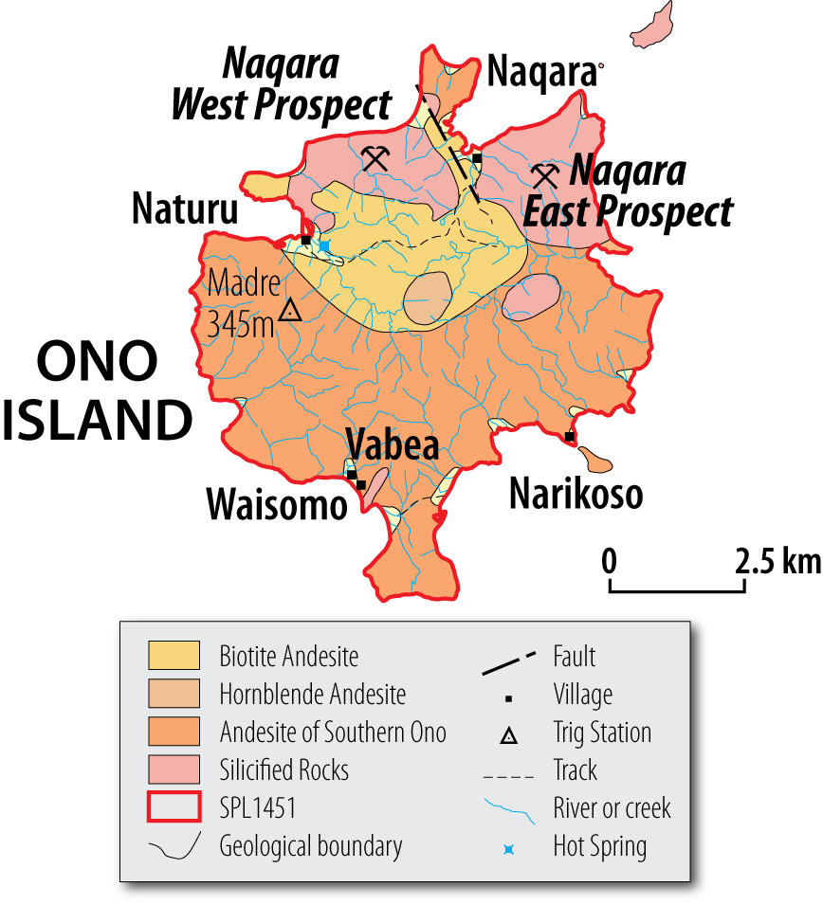
Ono Gold Project
Naqara East and West are two adjacent prospects (two square kilometers each)
Potential for discovery of a multi-million ounce gold deposit
Initial drilling program of 7 holes (total 2276m) completed July 2018
Drilling confirmed the presence of a very large mineralised system containing anomalous copper, molybdenum and other metals
Detailed data review and 3D modelling to be done to identify new gold targets within this system

Slide 18
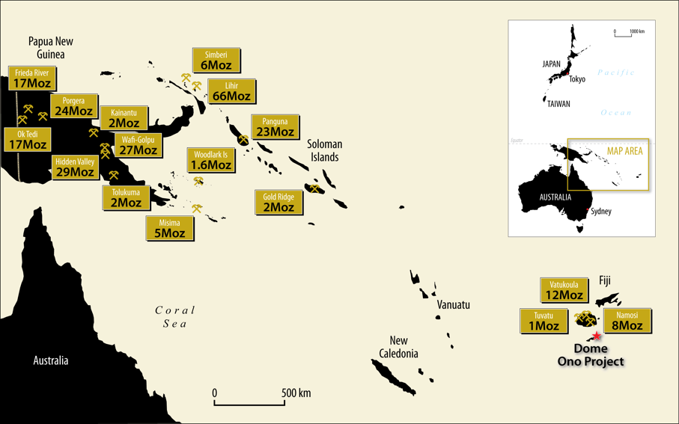
Significant gold deposits in the southwest Pacific

Slide 19
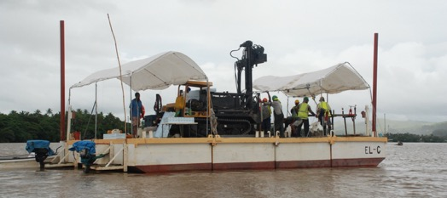
Dome’s path to success
Each of Dome’s projects is 100% owned by the Company
Each one is covered by an exploration tenement in good standing
Sigatoka is an advanced project, close to production and cash flow
Nadrau has world-class potential to be realised over the longer term
Ono second stage discovery drilling – with great scope to excite the market
Dome has the right people to take these projects forward

Slide 20
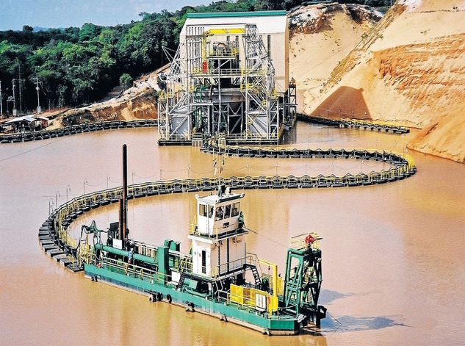
Dome is focused on creating wealth for its shareholders
This can be expressed by appreciation in our share price and by the payment of dividends once sustainable cash flow is achieved.
Major milestones in the creation of value are expected to be:
Commencement of production at Sigatoka
Discovery of an economic gold and copper deposit at Nadrau
Discovery of an economic gold deposit at Ono
A typical dredge mining operation, with floating mineral separation plant: IHC Robbins
Note: Not property of Dome

Slide 21
Dome aims to be the dominant player in the Fijian mining industry
We will achieve success with our high-quality projects and by leveraging our strong Fijian credentials to financial and cultural advantage.
We will pay our way with Sigatoka cash flow, thereby creating and retaining wealth for our shareholders.

Slide 22
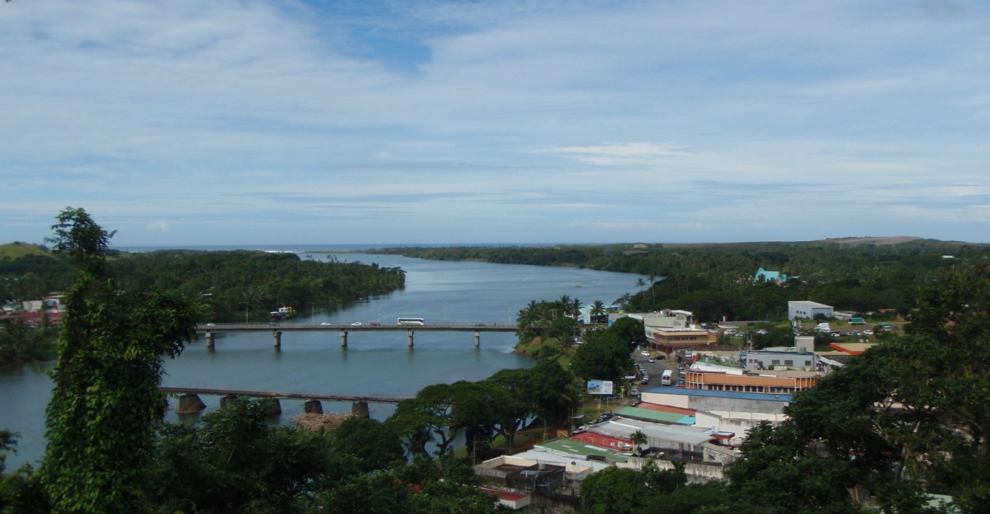
Dome is on the cusp of success
We offer:
Near term cash flow – development of Sigatoka
Medium term excitement – discovery of copper & gold
Future dividends – from sustainable cash flow
Low downside risk, thanks to Sigatoka
Major upside due to:
Copper and gold at Nadrau
Gold at Ono

Slide 23
Highly experienced board and management
CHAIRMAN
DIRECTOR
COUNTRY MANAGER FIJI
EXPLORATION FIJI
Jack McCarthy
Geologist
Tadao Tsubata
Investment Management
Darren Grant
Accountant
Semi Luvuiwai
Geologist
Landowner Relations
DIRECTOR
COMPANY SEC.
We have an established and highly experienced Board and a dedicated Management team with substantial in-country experience and technical and corporate expertise.
Sarah Harvey
Lawyer
Marcelo Mora
Accountant

Slide 24
Dome Gold Mines Limited
ABN 49 151 996 566
Leve 46, 680 George Street
Sydney NSW 2000 Australia
GPO Box 1759
Sydney NSW 2001 Australia
Web: www.domegoldmines.com.au
Enquiries
Jack McCarthy, Chairman
E: jack@domegoldmines.com.au
T: +61 2 8203 5620
March 2024 | Slide 24

Slide 25
Disclaimer
This presentation is for information purposes only. Neither this presentation nor the information contained in it constitutes an offer, invitation, solicitation or recommendation in relation to the purchase or sale of shares in any jurisdiction.
This presentation may not be distributed in any jurisdiction except in accordance with the legal requirements applicable in such jurisdiction. Recipients should inform themselves of the restrictions that apply in their own jurisdiction. A failure to do so may result in violation of securities laws in such jurisdiction. This presentation does not constitute financial product advice and has been prepared without taking into account the recipient’s investment objectives, financial circumstances or particular needs and the opinions and recommendations in this presentation are not intended to represent recommendations of particular investments to particular persons. Recipients should seek professional advice when deciding if an investment is appropriate. All securities transactions involve risks, which include (among others) the risk of adverse or unanticipated market, financial or political developments.
Competent Person’s Statement:
The information in this report that relates to Exploration Results is based on information compiled by John McCarthy, who I a non-executive Director and consultant to the Company. Mr McCarthy is a geologist who is a Member of the Australasian Institute of Mining and Metallurgy and has sufficient experience which is relevant to the style of mineralisation and type of deposits under consideration and to the activities which he is undertaking to qualify as a Competent Person as defined in the 2012 Edition of the ‘Australasian Code for Reporting of Exploration Results, Mineral Resources and Ore Reserves’. Mr McCarthy indirectly holds shares in the Company and consents to the inclusion in this report of the matters based on his information in the form and context in which it appears.
(i) All the material assumptions underpinning the resource estimates information in the initial public report (see ASX releases dated 23 October 2014, 11 December 2019 and 5 November 2020) continue to apply and have not materially changed.
No new exploration results for Namoli and Wainivau or Ono Island are reported in this release and further details of JORC 2012 compliant information, such as Table 1 disclosures, can be found in Dome’s previous ASX releases, quarterly activities reports or at the Company’s website: www.domegoldmines.com.au.
Forward Looking Statements
Certain statements contained in this presentation, including information as to the future financial or operating performance of Dome Gold Mines Limited (“Dome”) and or its subsidiaries and or its projects, are forward-looking statements. Such forward-looking statements: are necessarily based upon a number of estimates and assumptions that, whilst considered reasonable by Dome, are inherently subject to significant technical, business, economic, competitive, political and social uncertainties and contingencies; involve known and unknown risks and uncertainties that could cause actual events or results to differ materially from estimates or anticipated events or results reflected in such forward-looking statements; and may include, among other things, statements regarding targets, estimates and assumptions in respect of metal production and prices, operating costs and results, capital expenditures, ore reserves and mineral resources and anticipated grades and recovery rates, and are or may be based on assumptions and estimates related to future technical, economic, market, political, social and other conditions.
Dome disclaims any intent or obligation to update publicly any forward-looking statements, whether as a result of new information, future events or results or otherwise. The words “believe”, “expect”, “anticipate”, “indicate”, “contemplate”, “target”, “plan”, “intends”, “continue”, “budget”, “estimate”, “may”, “will”, “schedule” and other similar expressions identify forward-looking statements. All forward-looking statements made in this presentation are qualified by the foregoing cautionary statements. Investors are cautioned that forward-looking statements are not guarantees of future performance and accordingly investors are cautioned not to put undue reliance on forward-looking statements due to the inherent uncertainty therein.
Dome has prepared this presentation based on information available to it at the time of preparation. No representation or warranty, express or implied, is made as to the fairness, accuracy or completeness of the information, opinions and conclusions contained in the presentation. To the maximum extent permitted by law, Dome, its related bodies corporate (as that term is defined in the Corporations Act 2001 [Cth]) and the officers, directors, employees, advisers and agents of those entities do not accept any responsibility or liability including, without limitation, any liability arising from fault or negligence on the part of any person, for any loss arising from the use of the Presentation Materials or its contents or otherwise arising in connection with it.
To the extent permitted by law, Dome and its officers, employees, related bodies corporate and agents (“Agents”) disclaim all liability, direct, indirect or consequential (and whether or not arising out of the negligence, default or lack of care of Dome and/or any of its Agents) for any loss or damage suffered by a recipient or other persons arising out of, or in connection with, any use or reliance on this presentation or information.
Images of mining equipment and mining operations are not the property of Dome Gold Mines Ltd.

Slide 26
Appendix Tabulation of JORC 2012 resource estimates
ATTACHMENT A
SIGATOKA RIVER
HM Cut-off: 8%
JORC Classification | ZONE | DENSITY (g/cm3) | TONNES (Mt) | HM TONNES (Mt) | MAG1 TONNES (kt) | %HM Feed | %HM in Sand | +4mm Sand | 1 - 4mm Sand | 38 micron-1mm Sand | -38 micron | %MAG1 in Feed | %V in MAG1 | %TiO2 in MAG1 | %Fe in MAG1 | %SiO2 in MAG1 | %Al2O3 in MAG1 | %P in MAG1 | %S in MAG1
Indicated | Lower Fine Sand [ZONE 1] | 1.80 | 18.8 | 2.2 | 345 | 11.6 | 15.8 | 8.7 | 10.5 | 73.1 | 7.6 | 1.8 | 0.35 | 6.6 | 56.4 | 4.6 | 3.8 | 0.06 | 0.92
 | Upper Coarse Sand [ZONE 2] | 1.80 | 6.5 | 0.8 | 99 | 11.5 | 19.7 | 17.5 | 20.3 | 58.3 | 3.9 | 1.5 | 0.36 | 6.6 | 57.1 | 4.2 | 3.7 | 0.07 | 0.57
 | Subtotal | 1.80 | 25.3 | 2.9 | 444 | 11.6 | 16.8 | 11.0 | 13.0 | 69.3 | 6.7 | 1.8 | 0.35 | 6.6 | 56.6 | 4.5 | 3.7 | 0.06 | 0.83
Inferred | Lower Fine Sand [ZONE 1] | 1.80 | 4.6 | 0.5 | 76 | 10.7 | 15.7 | 10.4 | 13.1 | 68.6 | 7.9 | 1.7 | 0.36 | 6.6 | 56.9 | 4.4 | 3.7 | 0.06 | 1.08
 | Upper Coarse Sand [ZONE 2] | 1.80 | 1.4 | 0.2 | 15 | 10.8 | 19.9 | 21.1 | 20.9 | 53.5 | 4.5 | 1.1 | 0.36 | 6.6 | 57.4 | 4.3 | 3.8 | 0.07 | 0.36
 | Subtotal | 1.80 | 5.9 | 0.6 | 91 | 10.7 | 16.6 | 12.8 | 14.9 | 65.1 | 7.1 | 1.5 | 0.36 | 6.6 | 57.0 | 4.4 | 3.7 | 0.06 | 0.91
 | TOTAL | 1.80 | 31.2 | 3.6 | 535 | 11.4 | 16.8 | 11.3 | 13.4 | 68.5 | 6.8 | 1.7 | 0.4 | 6.6 | 56.7 | 4.5 | 3.7 | 0.1 | 0.8
KULUKULU
HM Cut-off: 8%
JORC Classification | ZONE | DENSITY (g/cm3) | TONNES (Mt) | HM TONNES (Mt) | MAG1 TONNES (kt) | %HM in Feed | %HM in Sand | +4mm Sand | 1 - 4mm Sand | 45 micron - 1mm Sand | -45 micron | %MAG1 in Feed | %Fe in MAG1 | %TiO2 in MAG1 | %SiO2 in MAG1 | %Al2O3 in MAG1
Inferred | Lower Fine Sands [ZONE 1] | 1.80 | 47.7 | 6.48 | 1,371 | 13.6 | 17.0 | 4.2 | 9.4 | 79.6 | 6.8 | 2.9 | 53.8 | 6.5 | 7.7 | 4.5
 | Upper Coarse Sands [ZONE 2] | 1.80 | 43.2 | 9.04 | 1,121 | 21.0 | 24.4 | 3.3 | 6.7 | 85.3 | 4.7 | 2.6 | 53.8 | 6.5 | 8.0 | 4.4
 | Elluvial Sands [ZONE 3] | 1.80 | 9.30 | 1.72 | 243 | 18.5 | 25.0 | 6.5 | 9.3 | 72.6 | 11.5 | 2.6 | 53.9 | 6.5 | 7.8 | 4.5
 | TOTAL | 1.80 | 100.2 | 17.2 | 2,735 | 17.2 | 21.0 | 4.0 | 8.2 | 81.4 | 6.3 | 2.7 | 53.8 | 6.5 | 7.8 | 4.5
KOROUA ISLAND
HM Cut-off: 8%
JORC Classification | REOURCE ZONE | DENSITY (g/cm3) | TONNES (Mt) | HM TONNES (Mt) | MAG1 TONNES (kt) | MAG2 TONNES (kt) | NON-MAG TONNES (kt) | %HM in Feed | %HM in Sand | +4mm Sand | 1 - 4mm Sand | -38 micron | Magnetite (% in HM) | Goethite (% in HM) | Hematite (% in HM) | Diopside (% in HM) | Garnet (% in HM) | Altered Ilmenite (% in HM) | Primary Ilmenite (% in HM) | Titanium Oxides (% in HM) | Titanite (% in HM) | Rutile (% in HM) | Hornblend (% in HM) | Other (% in HM) |  | XRF Fe (% in HM) | XRF Sulphur (% in HM) | XRF TiO2 (% in HM) | XRF SiO2 (% in HM) | XRF Al2O3 (% in HM) | XRF P (% in HM)
Indicated | Fine grained alluvial (lower layer) | 1.80 | 35.0 | 4.64 | 1,142 | 260 | 3,240 | 13.3 | 15.4 | 0.6 | 1.2 | 12.4 | 12.3 | 3.5 | 1.8 | 45.9 | 9.6 | 1.3 | 0.6 | 1.0 | 0.6 | 0.2 | 16.4 | 6.7 |  | 19.1 | 0.2 | 3.1 | 37.3 | 6.5 | 0.1
 | Coarse grained alluvial (upper layer) | 1.80 | 15.5 | 2.10 | 404 | 134 | 1,557 | 13.5 | 19.4 | 5.0 | 16.4 | 9.0 | 10.1 | 1.8 | 1.8 | 60.5 | 7.5 | 0.9 | 0.5 | 0.6 | 0.4 | 0.1 | 9.5 | 6.2 |  | 16.3 | 0.0 | 2.4 | 40.0 | 6.1 | 0.1
 | Eluvial Layer (uppermost) | 1.80 | 2.30 | 0.23 | 61 | 13 | 158 | 10.2 | 17.9 | 1.8 | 2.2 | 40.9 | 12.9 | 4.3 | 1.6 | 48.4 | 9.3 | 1.1 | 0.5 | 0.9 | 0.5 | 0.1 | 14.1 | 6.1 |  | 21.2 | 0.0 | 3.4 | 35.5 | 6.4 | 0.1
TOTAL |  | 1.80 | 52.7 | 7.0 | 1,607 | 407 | 4,955 | 13.3 | 16.7 | 1.9 | 5.7 | 12.6 | 11.7 | 3.0 | 1.8 | 50.4 | 8.9 | 1.2 | 0.6 | 0.9 | 0.5 | 0.2 | 14.3 | 6.5 |  | 18.3 | 0.1 | 2.9 | 38.1 | 6.4 | 0.1
Magnetic 1 Fraction (300 Gauss)
JORC Classification | REOURCE ZONE | MAG1 TONNES (kt) | Magnetite (% in HM) | Goethite (% in HM) | Hematite (% in HM) | Grainsize HM (microns) | Diopside (% in HM) | Garnet (% in HM) | Altered Ilmenite (% in HM) | Primary Ilmenite (% in HM) | Titanium Oxides (% in HM) | Rutile (% in HM) | Hornblend (% in HM) | Other (% in HM) | XRF Fe (% in HM) | XRF Sulphur (% in HM) | XRF TiO2 (% in HM) | XRF SiO2 (% in HM) | XRF Al2O3 (% in HM) | XRF Phosphorus (% in HM)
Indicated | Fine grained alluvial (lower layer) | 1,142 | 45.3 | 11.1 | 6.4 | 80 | 12.7 | 2.2 | 1.5 | 1.3 | 3.3 | 0.1 | 5.9 | 9.4 | 46.4 | 0.3 | 6.2 | 13.5 | 4.6 | 0.1
 | Coarse grained alluvial (upper layer) | 404 | 48.1 | 7.6 | 6.0 | 160 | 17.0 | 1.6 | 1.1 | 1.2 | 2.6 | 0.1 | 5.8 | 8.1 | 45.9 | 0.0 | 5.9 | 14.6 | 4.5 | 0.1
 | Eluvial Layer (uppermost) | 61 | 47.2 | 14.7 | 4.4 | 99 | 13.1 | 1.5 | 1.2 | 1.1 | 3.0 | 0.1 | 6.2 | 6.7 | 48.2 | 0.0 | 6.5 | 12.0 | 4.6 | 0.1
TOTAL |  | 1,607 | 46.1 | 10.4 | 6.2 | 100 | 13.8 | 2.0 | 1.4 | 1.3 | 3.1 | 0.1 | 5.9 | 9.0 | 46.4 | 0.2 | 6.2 | 13.7 | 4.6 | 0.1
Magnetic 2 Fraction (500 Gauss)
JORC Classification | REOURCE ZONE | MAG2 TONNES (kt) | Magnetite (% in HM) | Goethite (% in HM) | Hematite (% in HM) | Grainsize HM (microns) | Diopside (% in HM) | Garnet (% in HM) | Altered Ilmenite (% in HM) | Primary Ilmenite (% in HM) | Titanium Oxides (% in HM) | Rutile (% in HM) | Hornblend (% in HM) | Other (% in HM) | XRF Fe (% in HM) | XRF Sulphur (% in HM) | XRF TiO2 (% in HM) | XRF SiO2 (% in HM) | XRF Al2O3 (% in HM) | XRF Phosphorus (% in HM)
Indicated | Fine grained alluvial (lower layer) | 260 | 3.2 | 3.1 | 0.6 | 104 | 51.3 | 6.1 | 6.2 | 2.7 | 0.9 | 0.3 | 17.0 | 7.7 | 15.7 | 0.3 | 6.5 | 39.3 | 5.5 | 0.1
 | Coarse grained alluvial (upper layer) | 134 | 7.8 | 1.1 | 1.6 | 241 | 61.2 | 4.3 | 2.2 | 1.7 | 0.6 | 0.2 | 12.0 | 7.0 | 14.3 | 0.0 | 3.8 | 42.0 | 5.6 | 0.1
 | Eluvial Layer (uppermost) | 13 | 3.6 | 1.5 | 0.7 | 141 | 53.9 | 6.6 | 4.8 | 2.5 | 1.2 | 0.1 | 16.6 | 7.5 | 15.8 | 0.1 | 5.9 | 39.7 | 5.7 | 0.1
TOTAL |  | 407 | 4.7 | 2.4 | 0.9 | 150 | 54.6 | 5.5 | 4.9 | 2.4 | 0.8 | 0.2 | 15.4 | 7.4 | 15.2 | 0.2 | 5.6 | 40.2 | 5.5 | 0.1
Non-Magnetic Fraction
JORC Classification | REOURCE ZONE | NON-MAG TONNES (kt) | Magnetite (% in HM) | Goethite (% in HM) | Hematite (% in HM) | Grainsize HM (microns) | Diopside (% in HM) | Garnet (% in HM) | Altered Ilmenite (% in HM) | Primary Ilmenite (% in HM) | Titanium Oxides (% in HM) | Rutile (% in HM) | Hornblend (% in HM) | Other (% in HM) | XRF Fe (% in HM) | XRF Sulphur (% in HM) | XRF TiO2 (% in HM) | XRF SiO2 (% in HM) | XRF Al2O3 (% in HM) | XRF Phosphorus (% in HM)
Indicated | Fine grained alluvial (lower layer) | 3,240 | 1.4 | 0.9 | 0.3 | 103 | 57.1 | 12.4 | 0.9 | 0.2 | 0.2 | 0.3 | 20.1 | 5.6 | 9.7 | 0.1 | 1.7 | 45.6 | 7.2 | 0.1
 | Coarse grained alluvial (upper layer) | 1,557 | 0.5 | 0.3 | 0.8 | 260 | 71.8 | 9.3 | 0.8 | 0.3 | 0.1 | 0.0 | 10.3 | 5.6 | 8.8 | 0.0 | 1.4 | 46.4 | 6.6 | 0.0
 | Eluvial Layer (uppermost) | 158 | 0.5 | 0.5 | 0.7 | 146 | 61.6 | 12.5 | 0.8 | 0.1 | 0.1 | 0.1 | 16.9 | 5.8 | 11.3 | 0.0 | 2.1 | 44.2 | 7.1 | 0.1
TOTAL |  | 4,955 | 1.1 | 0.7 | 0.5 | 154 | 61.9 | 11.4 | 0.8 | 0.2 | 0.2 | 0.2 | 16.9 | 5.6 | 9.5 | 0.1 | 1.6 | 45.8 | 7.0 | 0.1
Note: The table presents the Indicated and Inferred estimates without rounding and this is not intended to convey an increase in the precision of the estimates.
The cut-off grade used is 8% HM.
Mag 1 represents magnetic minerals captured at 300 Gauss.
See ASX releases dated 10 October 2014, 11 December 2019 and 5 November 2020

